Slide 1


Tyro Mill Preliminary Assessment/Site Investigation
CENE 486C: ENGINEERING DESIGN
APRIL 26, 2019
PREPARED BY: CAITLIN ADAMS. JOY CRUTCHFIELD. ERYN GUEVARA. HAMAD MOHAMMAD

Slide 2
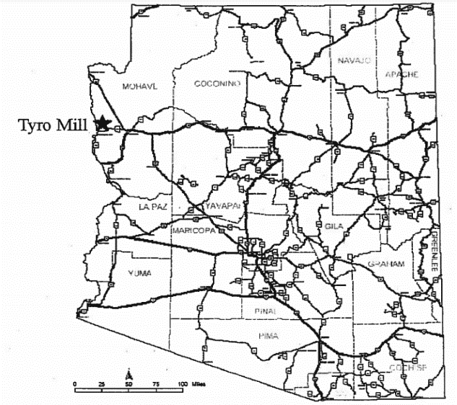
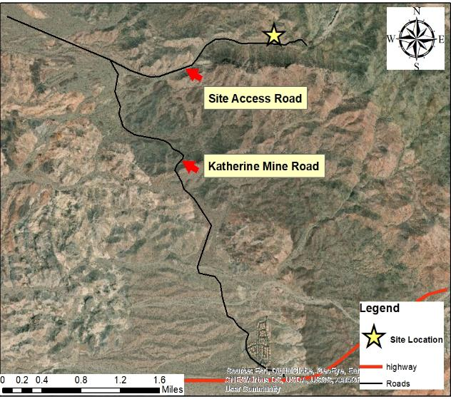
Tyro Mill Project Overview
Client
The Bureau of Land Management
Contact: Eric Zielske, P.E.
Project Location
Mohave County, AZ
Intersection of AZ Highway 68 and Katherine Mine Road
15 miles northeast of Bullhead City [1]
Figure 1. Tyro Mill Shown on Arizona Map [1].
Figure 2. Tyro Mill Site Location Showing Route to Site from AZ Highway 68 [1].

Slide 3
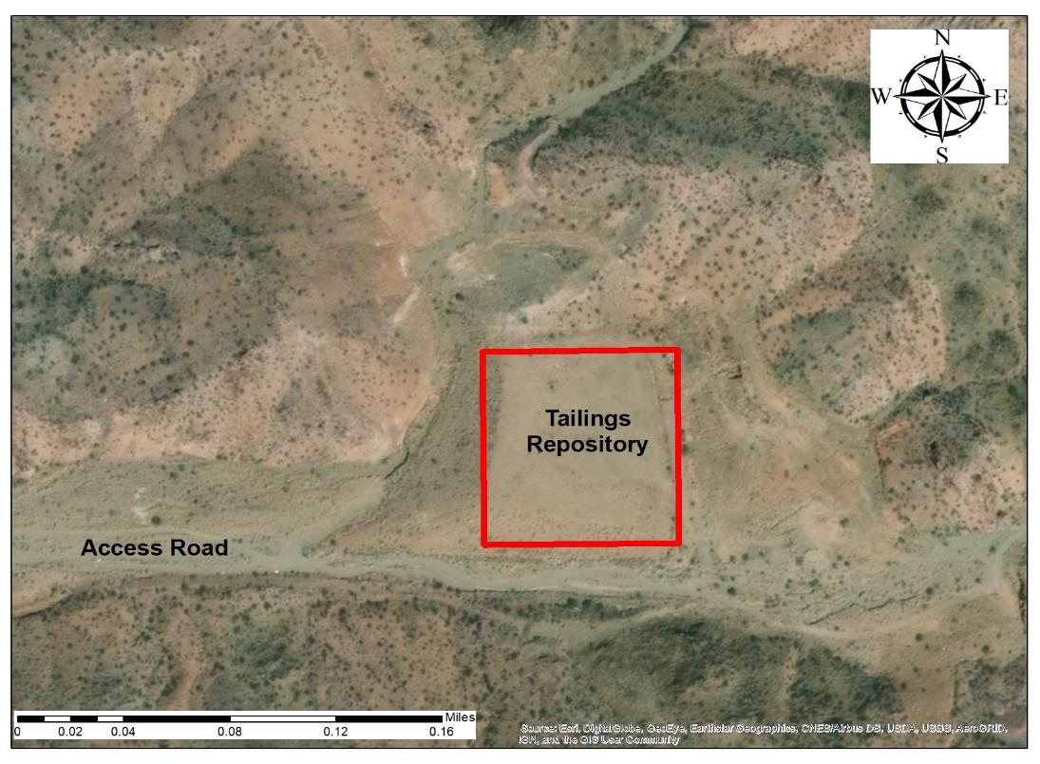
Tyro Mill Project Overview
Site History and Current Site Conditions
Abandoned mill site that processed ores from several nearby mines
Mill operated for 20 years before being abandoned in 1999
Red J Environmental constructed the current mine tailings repository in 2004
Figure 4. Tyro Mill Current Site Conditions [3].

Slide 4
Tyro Mill Project Overview
Table 1. April 2018 Sampling Event Results [3].
The most recent sampling event occurred in April of 2018
Concerning levels of uranium, arsenic, nickel, manganese, and antimony were detected via X-Ray Fluorescence analysis on the site [3]

Slide 5
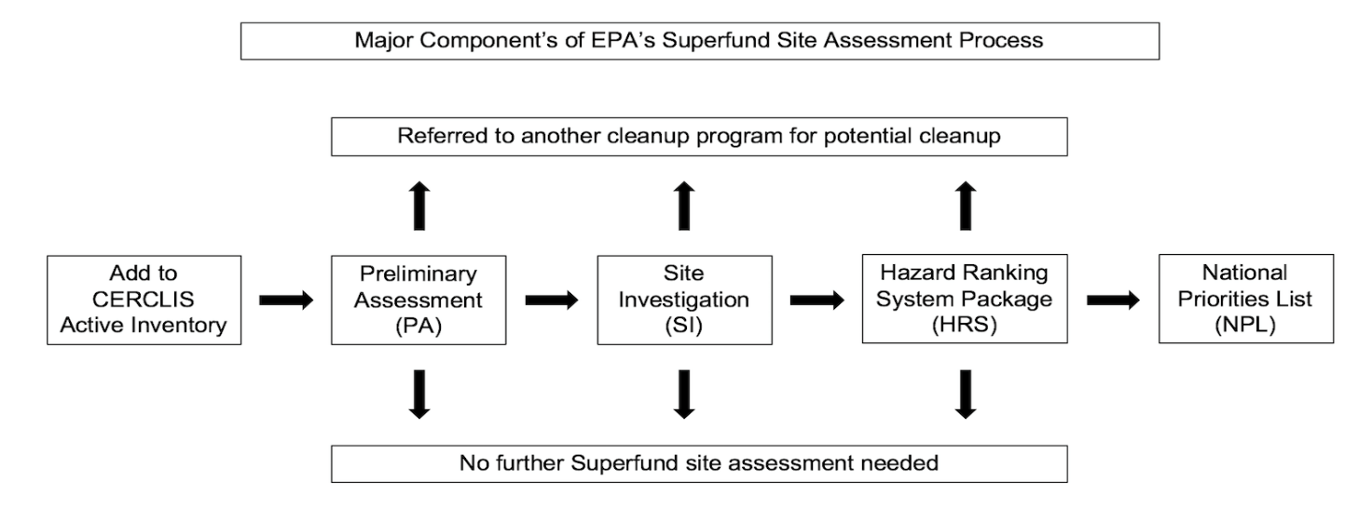
Tyro Mill Project Overview
Purpose
To provide the client with information on the contamination present at the Tyro Mill site through the development of a Preliminary Assessment/Site Investigation report
What is a Preliminary Assessment/Site Investigation Report?
The first step in the CERCLA (Superfund) process
Evaluate whether the contamination present at site poses a significant threat to human health [2]
Figure 3. EPA’s Superfund Assessment Process Showing the Location of the PA/SI step [2].

Slide 6
Project Scope
Task 1: Work Plan
1.1 Sampling and Analysis Plan (SAP)
1.2 Health and Safety Plan
Task 2: Sampling
Task 3: Analysis
3.1 Sieving and Drying
3.2 X-Ray Fluorescence (XRF) Analysis
3.3 Flame Atomic Absorption Spectroscopy (FAAS) Analysis (Subcontracted to Western Technologies)
3.4 XRF and FAAS Correlation
Task 4: Risk Assessment
4.1 Human Risk Assessment
4.2 Ecological Risk Assessment
Task 5: Project Impacts
Task 6: Project Management
6.1 Meetings
6.2 Correspondence
6.3 Schedule Management
6.4 Project Deliverables

Slide 7
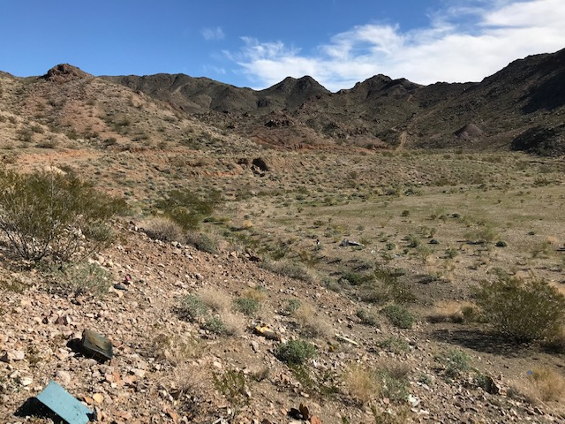
Development of the Work Plan
Sampling and Analysis Plan (SAP)
  Field Grid Sampling Methods and Procedures
  Labeling of Samples and Containers
  Sample Transportation, Packing, and Preservation
Health and Safety Plan (HASP)
  Decontamination Procedures
  Safety Training Requirements
  Emergency Response Procedures
Figure 4. Tyro Mill Site Looking South.

Slide 8
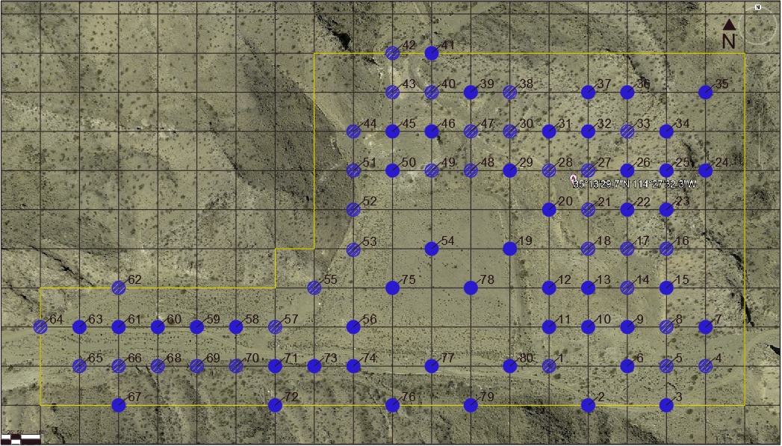
Sampling Plan
On-Site Sampling Event
  Two Day Sampling Event
  (Friday 1/25 to Saturday 1/26)
  70 Grid Samples
  Hot Spot Samples
  Background Samples
Figure 5. Original Grid Sampling Map Prepared in Work Plan.

Slide 9
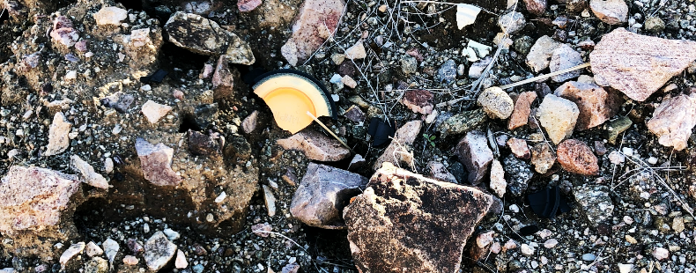
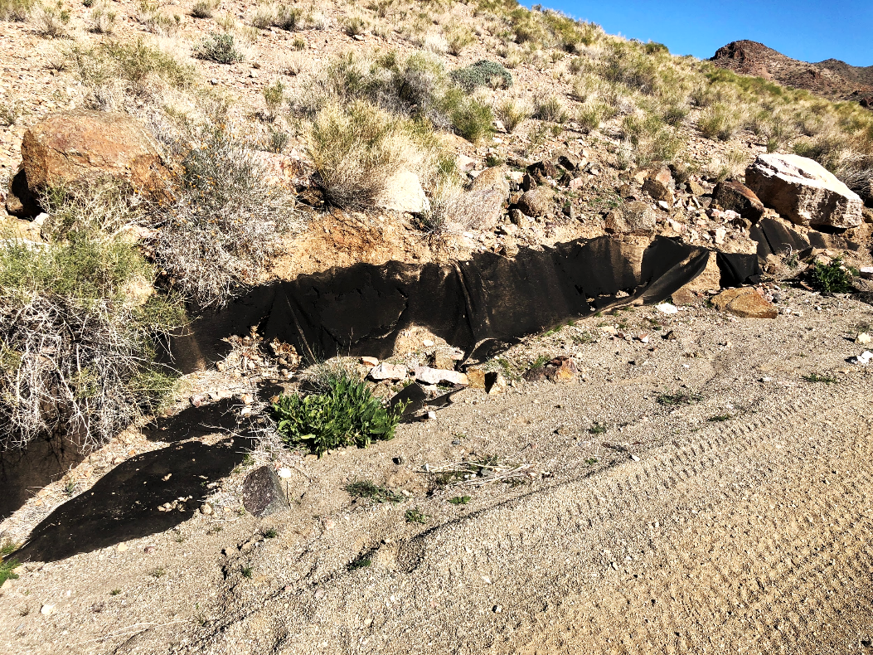
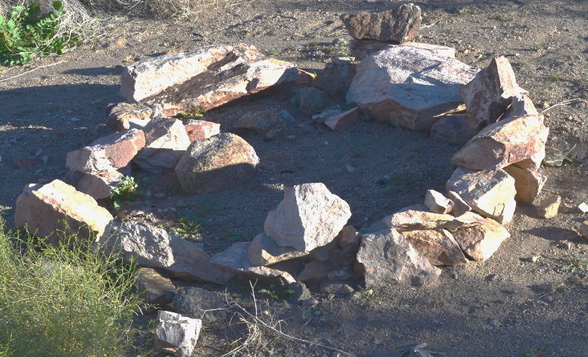
Current Site Conditions
Figure 6. Evidence of Target Shooting on Repository.
Figure 7. Fire Pit Found near Grid Sample 57
Figure 8. Exposed Liner found on the West End of Site

Slide 10
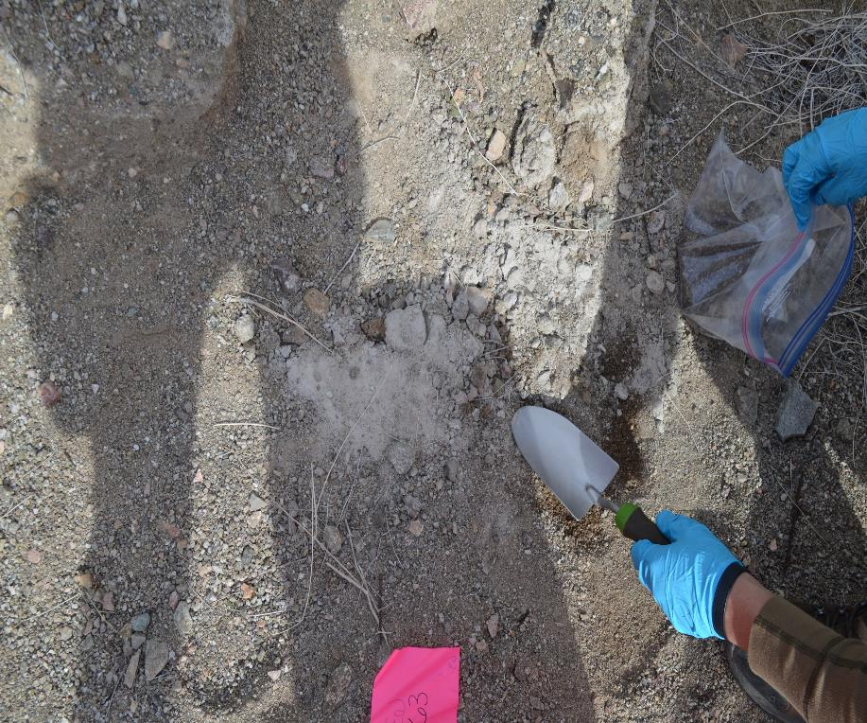
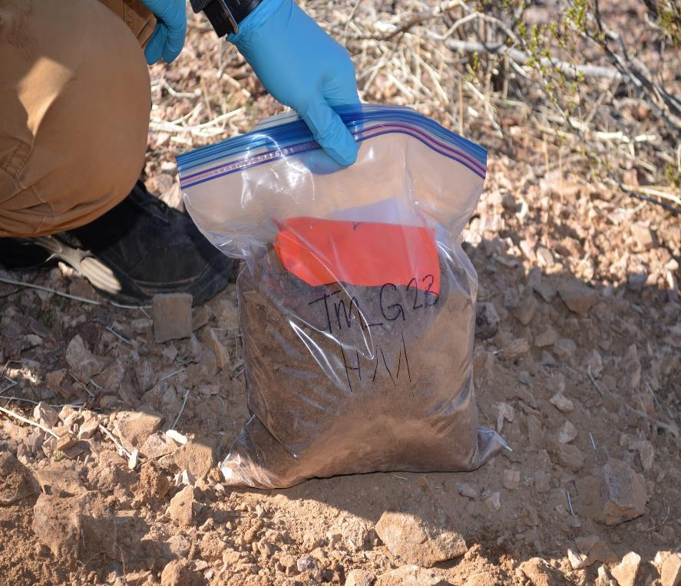
Field Sampling
Figure 9. Visible Mine Tailings Found Near Repository.
Figure 10. Example Procedure of QA/QC followed for Every Sample
Notes:
Add in pics of us sampling

Slide 11
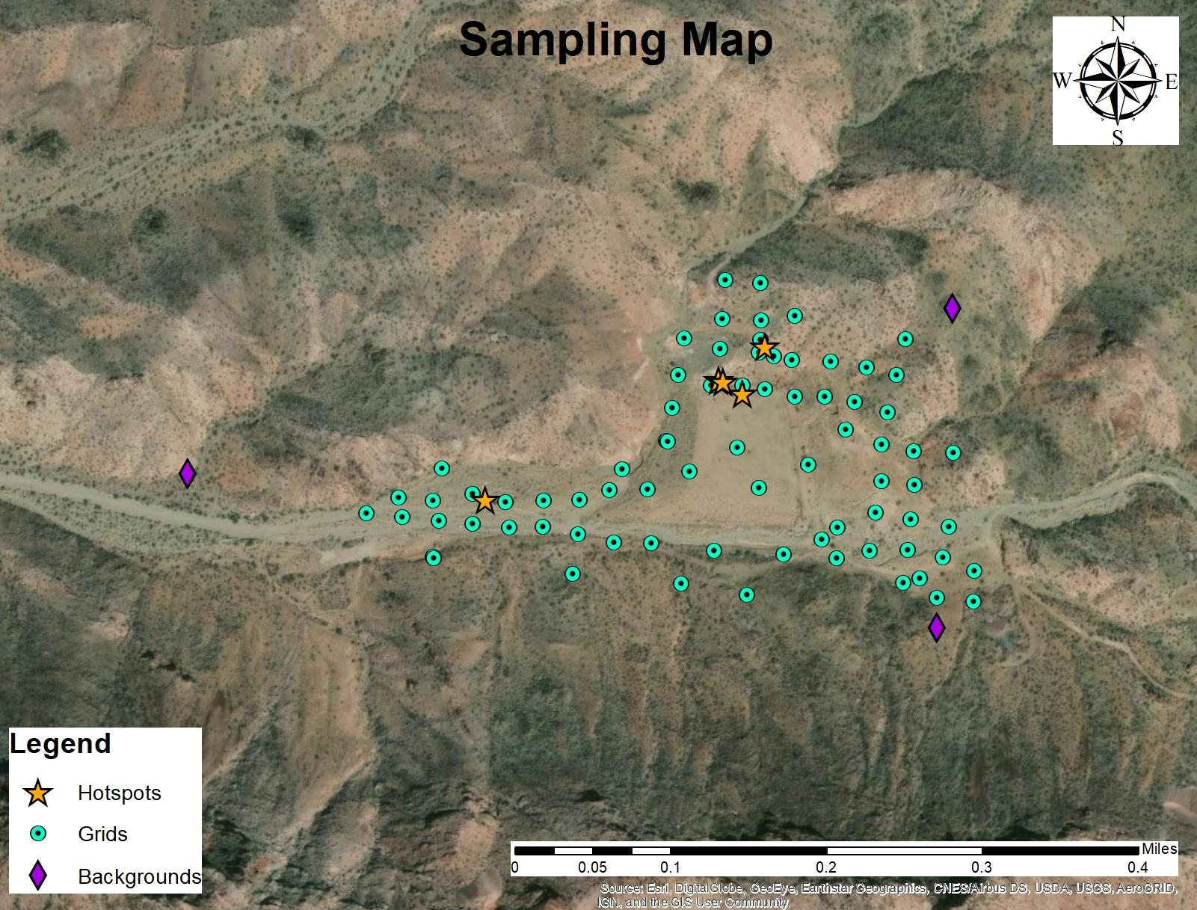
Sampling

Slide 12
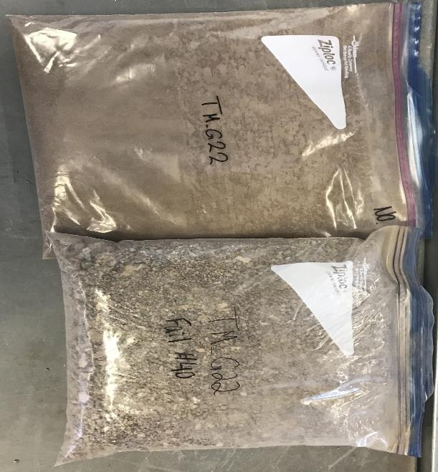
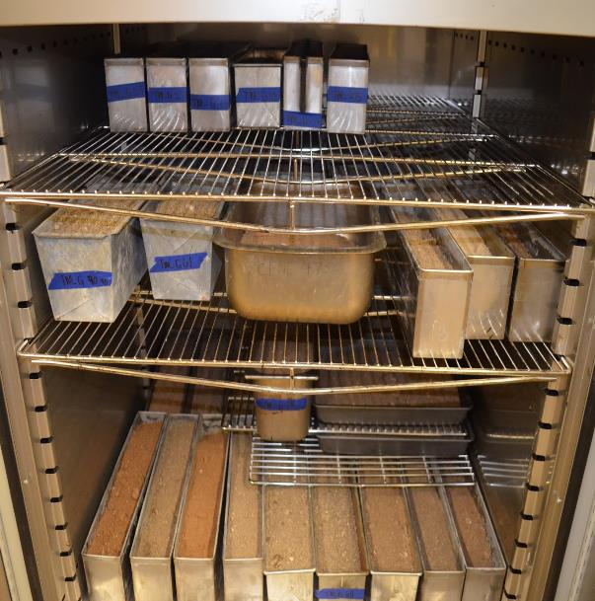
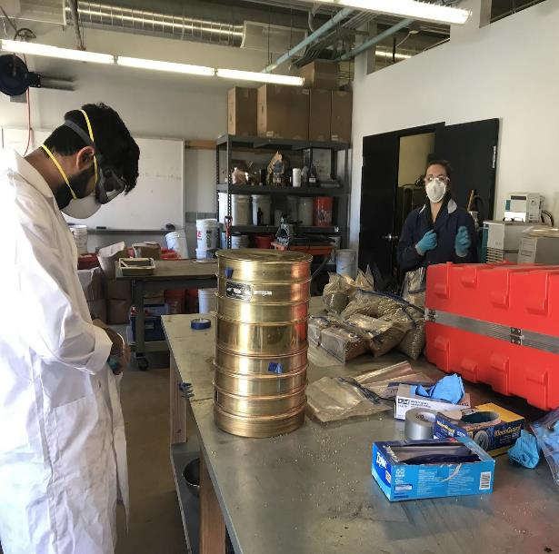
Drying and Sieving of Samples
Figure 11. Samples Drying
Figure 12. Samples Being Prepared for Sieving
Figure 13. Grid Sample 22 after Completing Sieving

Slide 13
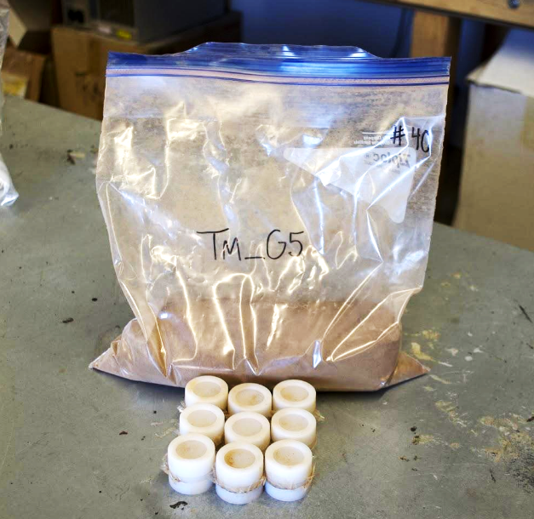
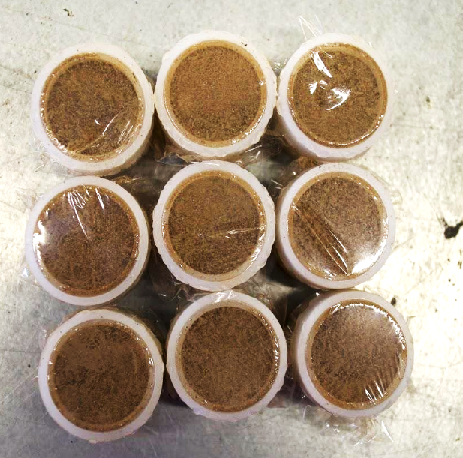
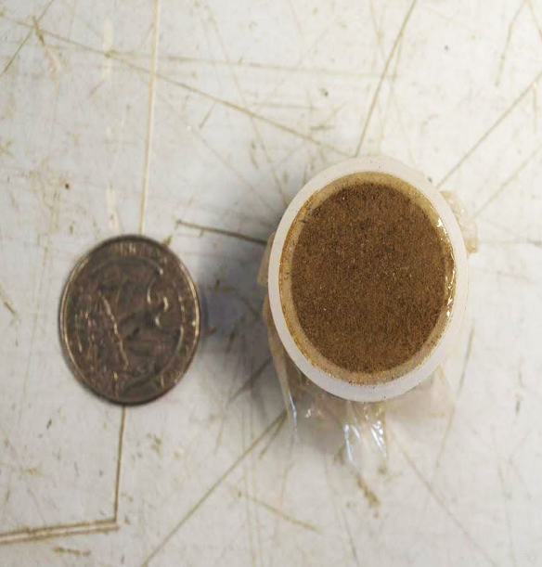
X-Ray Fluorescence Analysis
Figure 14. Soil Sample with XRF Cups
Figure 15. Nine Prepared Samples to be XRF
Figure 16. Size Reference of XRF cup

Slide 14
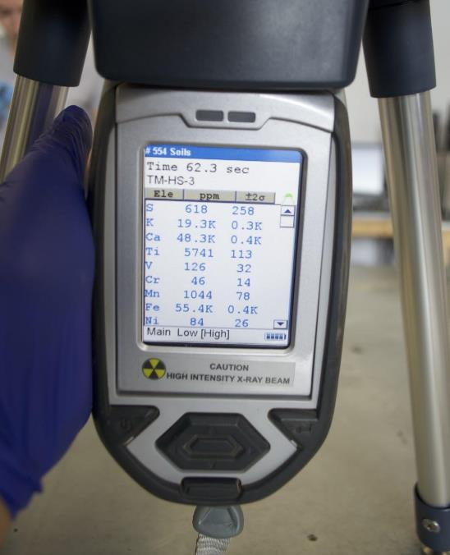
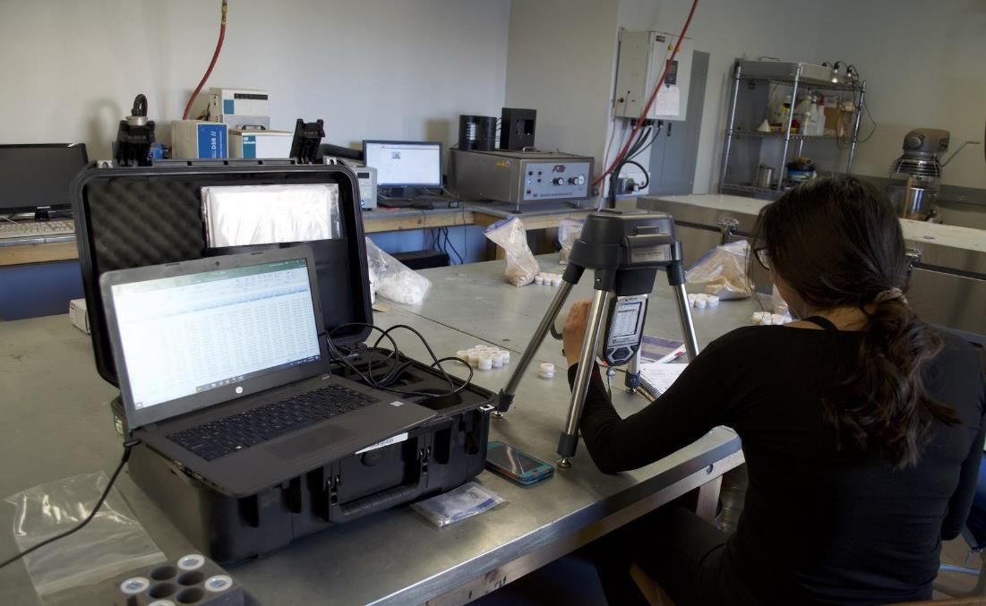
X-Ray Fluorescence Analysis
Figure 17. XRF Reading of a Soil Sample
Figure 18. XRF Analysis

Slide 15
Identification of Contaminants of Concern
Human Health Criteria
Ecological Criteria
Arizona Residential and Non-Residential Soil Remediation Standards [4]
  Primary Focus on Non-Residential Standards
EPA Ecological Screening Criteria [4]
  Plants
  Mammals
  Birds

Slide 16
X-Ray Fluorescence Analysis Results
Figure 19. XRF Data for Arsenic Showing Samples with Concentration Higher than the 10 PPM Regulatory Standard.

Slide 17
Selected Contaminants of Concern
Ecological
Lead
Zinc
Manganese
Vanadium
Cadmium
Human Health
Arsenic

Slide 18
Data Correlation and XRF Correction
Corrected Value = 0.3376*XRF value
Figure 20. Data Correlation Developed Between XRF and FAA Results.
Notes:
We will need to very clearly and explicitly explain the correlation graph

Slide 19
Corrected XRF Data for Arsenic
Figure 21. XRF Data Showing Arsenic Exceedances After Correction Using Correlation Equation.

Slide 20
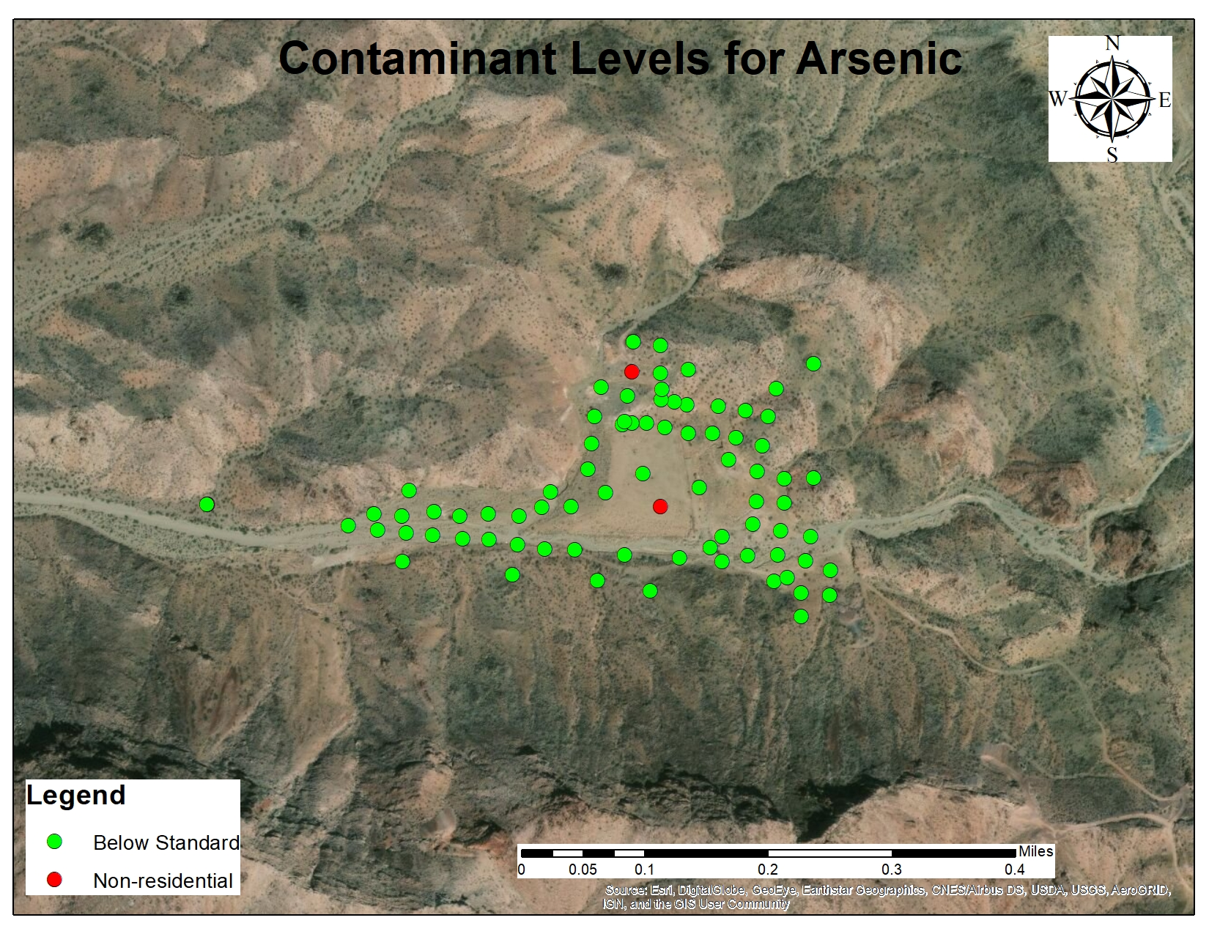
Human Health Risk Assessment

Slide 21
Exposure Point Concentrations
Table 2. Exposure Point Concentration Values
Exposure Point Concentrations (PPM)
50% EPC | 4.7
95% EPC | 9.1
Figure 21. Distribution Graph for Arsenic Concentrations [5].
Notes:
Add in distribution curve

Slide 22
Human Health Risk Assessment
Contaminants of Concern for Human Health
Arsenic
Exposure Pathways
14 Day Recreational Exposure by Ingestion of Contaminated Soil (Adult and Child)
14 Day Recreational Exposure by Dermal Contact with Contaminated Soil (Adult and Child)
Carcinogenic Risk
Non-Carcinogenic Risk
Cancer Risk = Chronic Daily Intake x EPA Cancer Slope Factor
Where:
Chronic Daily Intake: Calculated Based on Exposure Scenario
EPA Cancer Slope Factor for Arsenic: 1.5 kg-day/mg [7]
Hazard Index = Chronic Daily Intake / EPA Reference Dose
Where:
Chronic Daily Intake: Calculated Based on Exposure Scenario
EPA Reference Dose for Arsenic: 0.0003 mg/kg-day [7]

Slide 23
Human Health Risk Assessment
Chronic Daily Intake Rate Calculation Ingestion of Contaminated Soil Exposure Pathway
Table 3. CDI Calculation Values [9].
CDI = CS x IR x CF x ED x EF x ED
BW x AT
CDI = Chronic Daily Intake (mg/kg-day)
CS = Chemical Concentration in Soil
(mg Arsenic/kg soil)
IR = Ingestion Rate of soil (mg soil/day)
CF= Conversion Factor (mg soil/ kg soil)
EF= Exposure Frequency (days/year)
ED = Exposure Duration (years)
BW = Body weight (kg)
AT = Averaging Time (days) [8] [9]

Slide 24
Human Health Risk Assessment
Chronic Daily Intake Rate Calculation Dermal Contact with Contaminated Soil Exposure Pathway
CDI = CS x CF x SA x E x AF x ABS x ED x EF x ED
BW x AT
Table 4. CDI Calculation Values [9].
CDI = Chronic Daily Intake (mg/kg-day)
CS = Chemical Concentration in Soil
(mg Arsenic/kg soil)
CF= Conversion Factor (mg soil/ kg soil)
SA = Skin Surface Area available
(cm2 skin/event)
E = Number of Events (event/exposure)
AF = Soil-to-Skin Adherence Factor
(mg soil/cm2 skin)
ABS = Absorption Factor
EF= Exposure Frequency (days/year)
ED = Exposure Duration (years)
BW = Body weight (kg)
AT = Averaging Time (days) [8] [9]

Slide 25
Human Health Risk Assessment
Table 5. Human Health Risk Assessment Results Carcinogenic.
A site is considered a risk to human health if the Carcinogenic Risk is higher than 1x10⁻⁶ or if the Non-Carcinogenic Risk is higher than 1.0
The Arsenic contamination at the Tyro Mill site does not pose a significant risk to human health [8]
Table 6. Human Health Risk Assessment Results Non-Carcinogenic.

Slide 26
Ecological Risk Assessment
Table 7. EPA Ecological Soil Screening Levels [4].
Ecological Soil Screening Levels in PPM
Contaminant | Plants | Avian Wildlife | Mammals
Lead | 120 | 11 | 56
Arsenic | 18 | 43 | 46
Zinc | 160 | 46 | 79
Copper | 70 | 28 | 49
Nickel | 38 | 210 | 130
Manganese | 220 | 4300 | 4000
Vanadium | - | 7.8 | 280
Cadmium | 32 | 0.77 | 0.36
Silver | 560 | 4.2 | 14
Barium | - | - | 2000
Table 8. Number of Samples that Exceeded Ecological Soil Screening Levels.
Number of Samples with Exceedances of Eco. Risk Standards
Eco. Type | Lead | Zinc | Manganese | Vanadium | Cadmium
Birds | 43 | 37 | 0 | 65 | 33
Mammals | 1 | 19 | 0 | 0 | 1
Plants | 2 | 0 | 61 | 0 | 1

Slide 27
Ecological Risk Assessment
Birds
California Condor
California Least Tern
Mammals
Wild Burros
Bighorn Sheep
Hualapai Mexican Vole
Plants
Desert Marigold
Fickeisen Plains Cactus
Fire Barrel Cactus
Other
Desert Tortoise [10]
Figure 22. Hualapai Mexican Vole [10].
Figure 23. Desert Marigold [10].
Figure 24. California Condor [10].
Figure 25. Desert Tortoise [10].

Slide 28
Project Impacts
Environmental
  Continuation of repository cap erosion may increase the risk for contamination
  Native Flora and Fauna on or near the site may be at risk
Social
  Recreational use at the site may continue without restriction
Economic
  The Bureau of Land Management must perform Five Year Reviews of the Tyro Mill site if the remediation currently in place were to fail
  Further remediation may be necessary at the site if the tailings repository liner were to fail

Slide 29
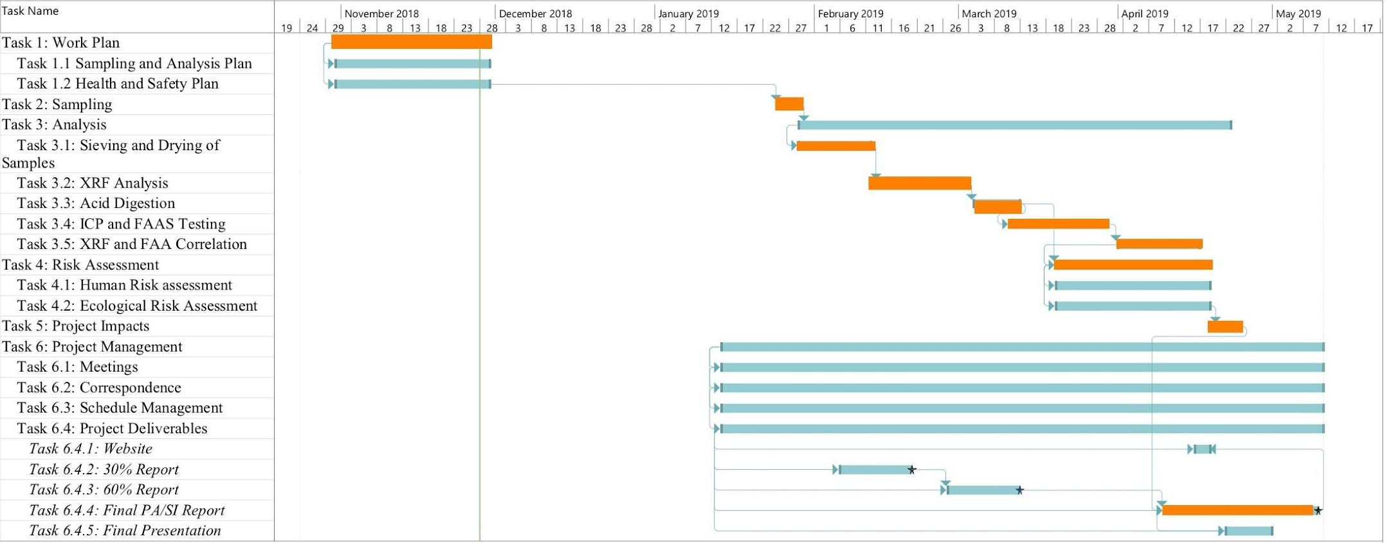
Predicted Project Schedule

Slide 30
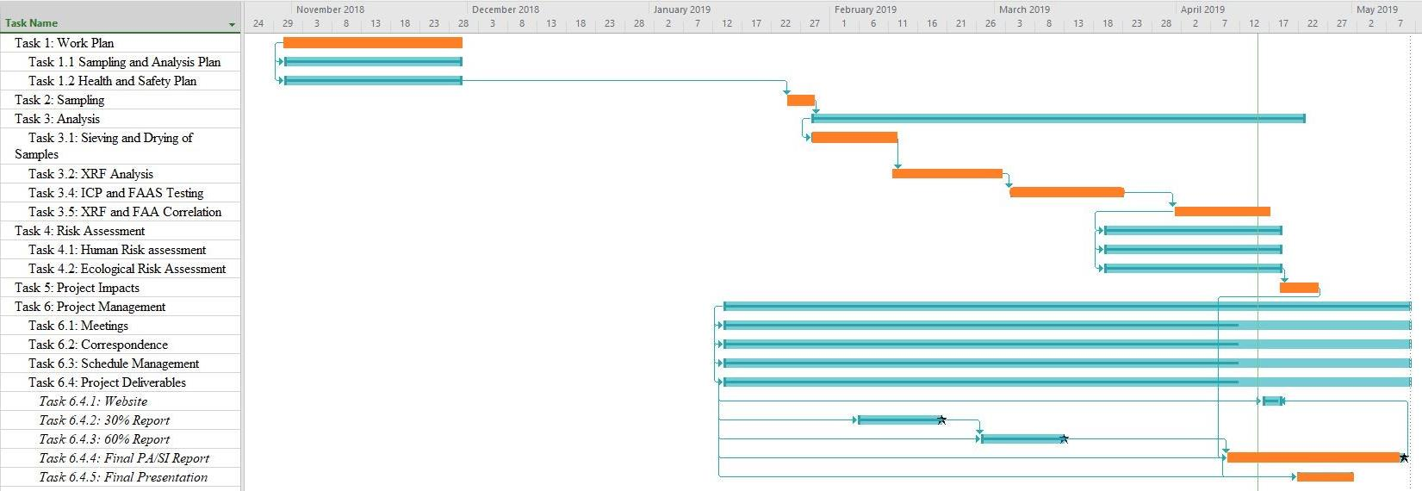
Current Gantt Chart

Slide 31
Projected and Actual Project Hours
Table 9. Projected Hours Required to Complete Project.
Table 10. Actual Hours Required to Complete Project.

Slide 32
Projected Cost of Engineering Services
Total Projected Cost: $81,276

Slide 33
Actual Cost of Engineering Services
Actual Project Cost: $57,424
Under Budget by $23,852
Subcontracting was less than planned for
Total Hours were below the original projection.

Slide 34

Conclusions
The current tailings repository is sufficiently containing the contamination on site
If the tailings repository continues to erode, it may fail and allow contamination to spread across the site
The shooting range on the site may cause additional contamination, so the team suggests the BLM post signs restricting target shooting in the area
Figure 26. The Team After the First Day of Sampling.
Notes:
Will need to talk about the final results and the recommendations of the site

Slide 35
References
[1]Bureau of Land Management, "Draft Final Engineering Evaluation/Cost Analysis Tyro Mill Site Kingman Field Office, Arizona," U.S. Department of Interior Bureau of Land Management Kingman Field Office, Kingman, 2002.
[2] US EPA “Superfund Site Assessment Process”, US EPA Website. [Online]. Available: https://www.epa.gov/superfund/superfund-site-assessment-process
[3] E. Zielske, Interviewee, CENE 476 Client Meeting. [Interview]. 7 September 2018.
[4] Department of Environmental Quality, "Arizona Administrative Code Title 18. Environmental Quality Chapter 7. Department of Environment Quality Remedial Action", The Office of the Secretary of State, 2009.
[5] U. Olsson, "Confidence Intervals for the Mean of a Log-Normal Distribution", Journal of Statistics Education, 2005. [Online]. Available: http://jse.amstat.org/v13n1/olsson.html. [Accessed: 16- Apr- 2019].
[6] Agency for Toxic Substances and Disease Registry, "Arsenic", Division of Toxicology and Environmental Medicine ToxFAQs, Atlanta, 2007.
[7] "Arsenic, Inorganic CASRN 7440-38-2 | IRIS | US EPA, ORD", EPA, 2017. [Online]. Available: https://cfpub.epa.gov/ncea/iris2/chemicalLanding.cfm?substance_nmbr=278. [Accessed: 16- Apr- 2019].
[8] M. LaGrega, P. Buckingham and J. Evans, Hazardous waste management. New Delhi, India: MedTech, 2015.
[9] United States Environmental Protection Agency, "Update for Chapter 5 of the Exposure Factors Handbook Soil and Dust Ingestion", National Center of Environment Assessment Office of Research and Development, Washington, 2017.
[10] Loarie et al. “iNaturalist Standard Places v1.0” [Online]. Available: http://www.inaturalist.org/pages/inat+standard+places

